Slide 1
Welcome to
Our Sunday School
We’ll start at 9:07
visit OurSundaySchool.com for more about our class

Slide 2
Today’s class (page 106)
Preparing for Philippians 2:1-30
Pray with others
Hear with others
Think with others
Study with others In class, as a table
Share with others
Invite others After class
In class, as a class

Slide 3
Prayer Time
Write down your prayer requests (on the Weekly Update or in the comments)
Lean in, engage, and pray for someone not with you
Go worship

Slide 4
Today’s class (page 16)
Preparing for Philippians 1:1-30
Pray with others
Hear with others
Think with others
Study with others In class, as a table
Share with others
Invite others After class
In class, as a class

Slide 5
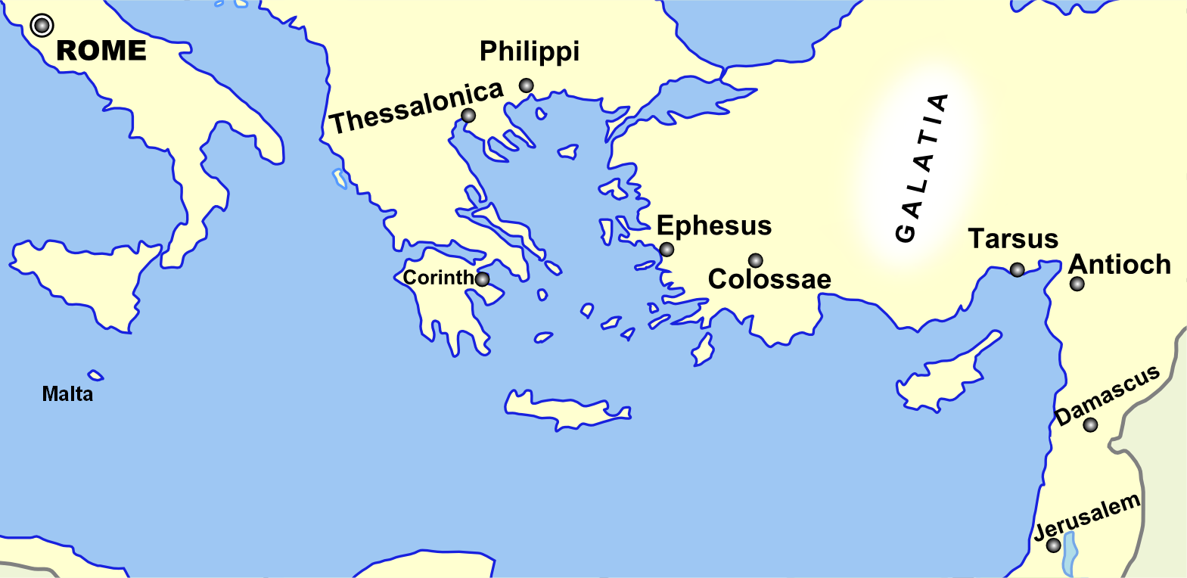
Monozigote. (2012). Broad Overview of Geography Relevant to Paul of Tarsus [Map]. Wikipedia.

Slide 6
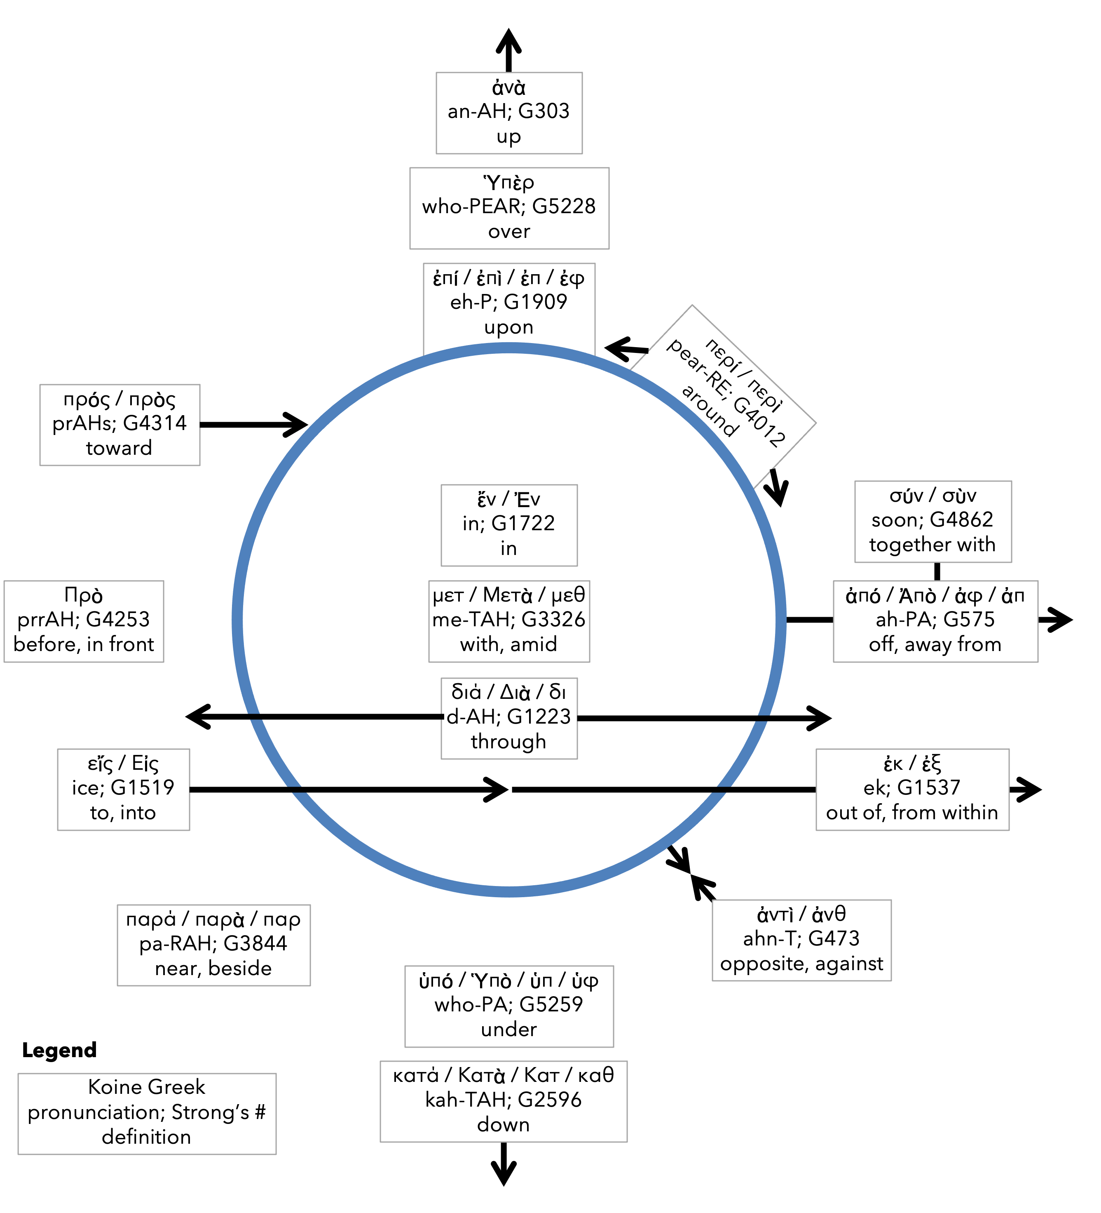
Preposition circle (page 11)

Slide 7
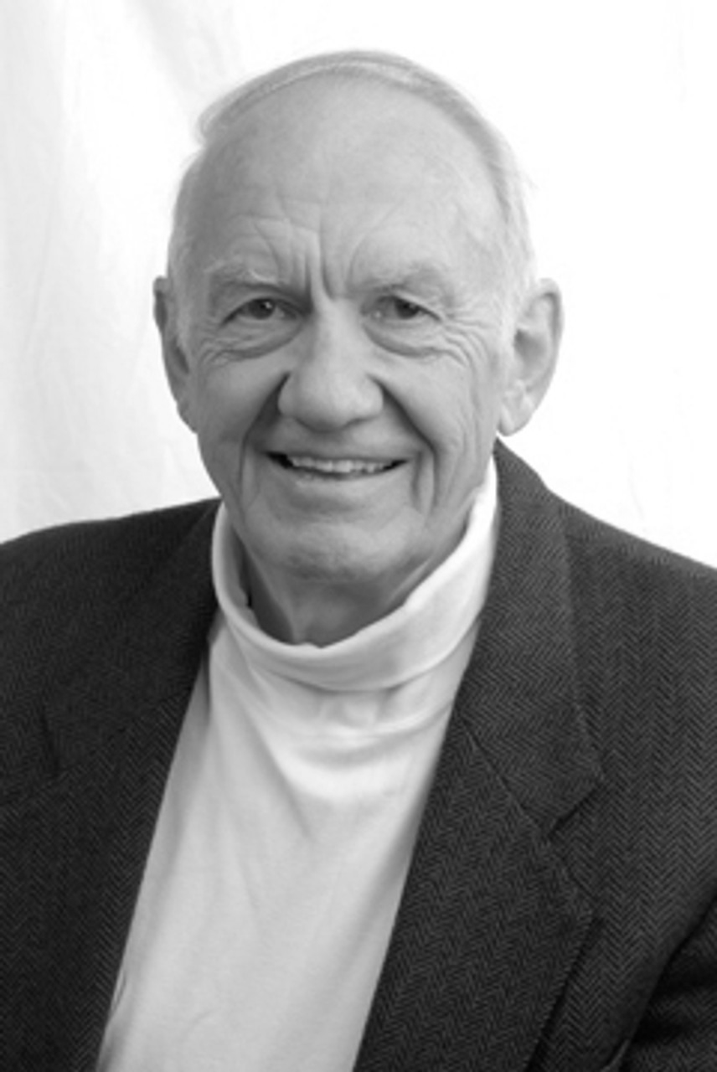
Dr. Gordon Fee Quote

Slide 8
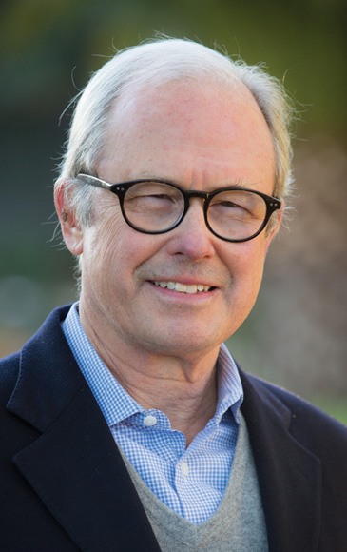
Dr. G. Walter Hansen Quote

Slide 9
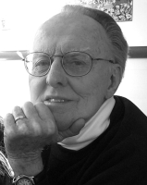
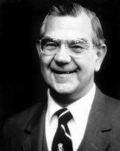
Dr. G. F. Hawthorne & Dr. Ralph P. Martin Quote

Slide 10
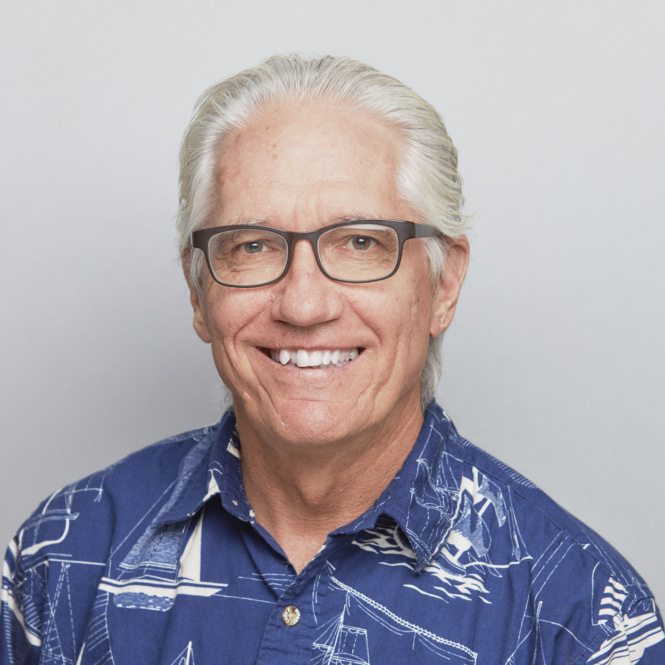
Dr. Joe Hellerman Quote

Slide 11
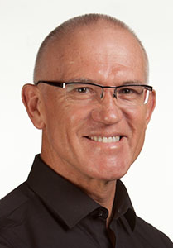
Dr. Mark Keown Quote

Slide 12
Dr. Ralph P. Martin Quote

Slide 13
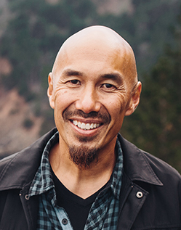
Dr. Tony Merida & Frances Chan Quote

Slide 14
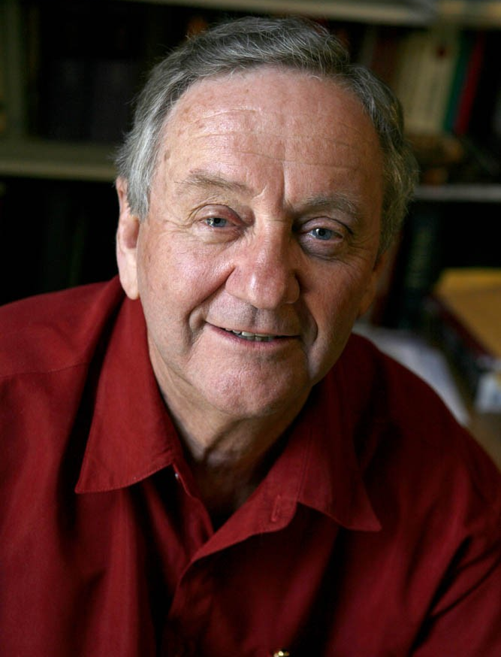
Dr. Peter T. O’Brien Quote

Slide 15
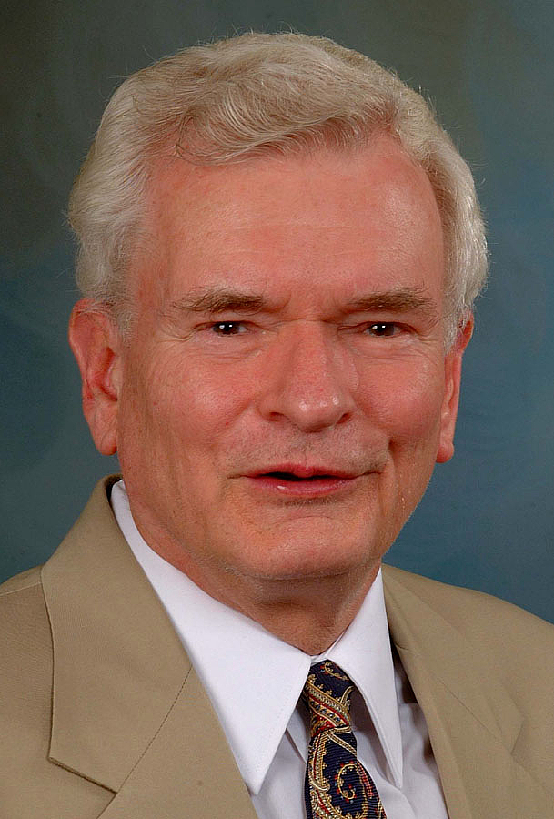
Dr. John Reumann Quote

Slide 16
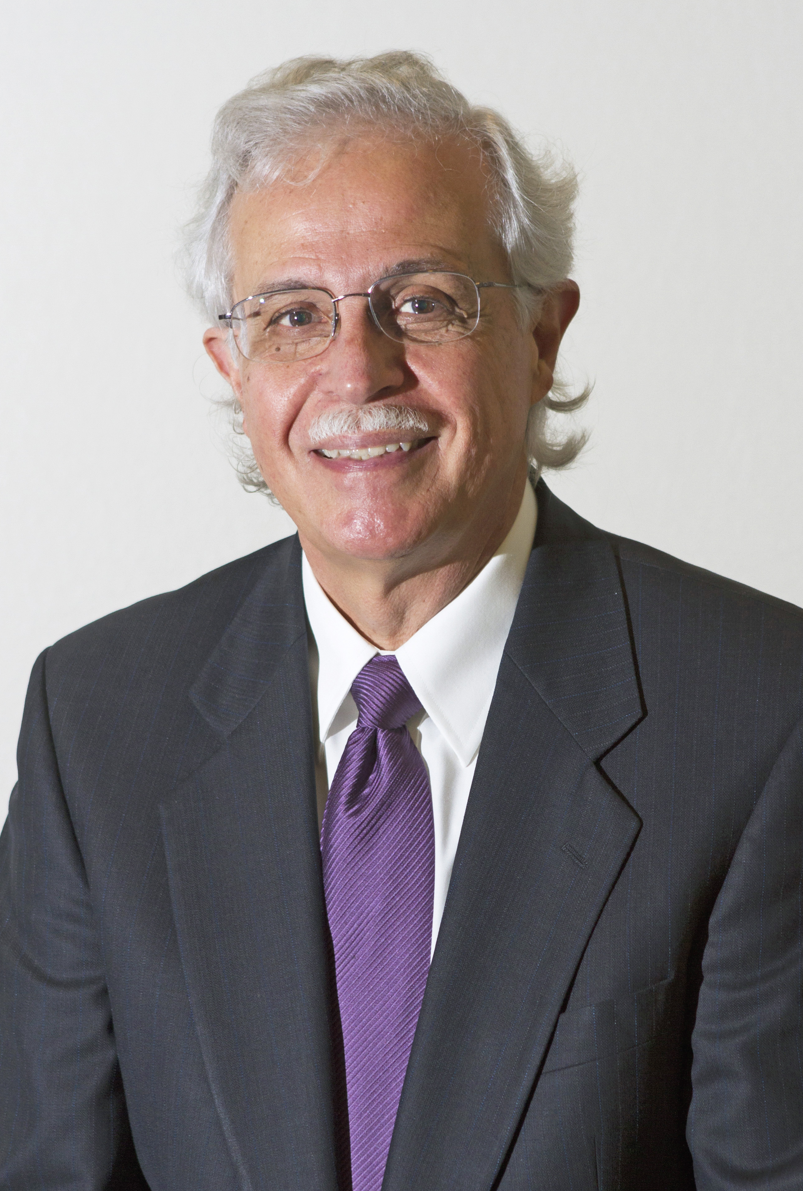
Dr. Moises Silva Quote

Slide 17
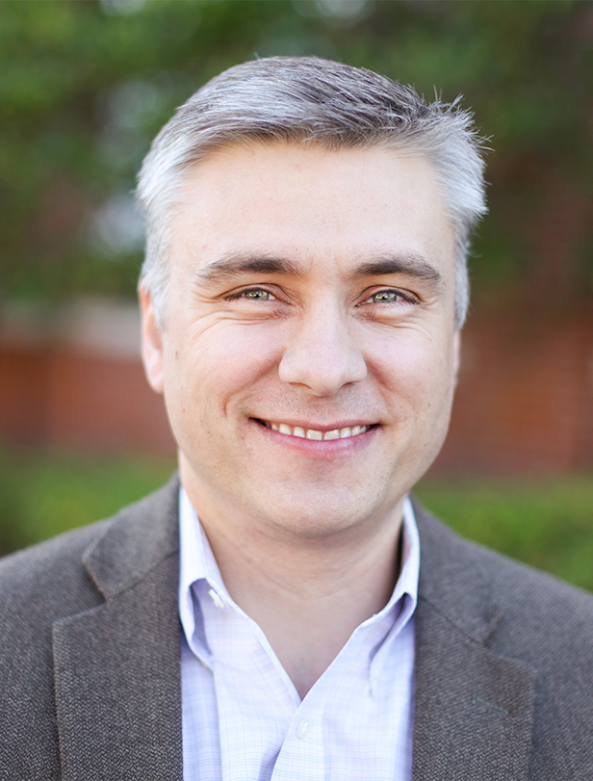
Dr. David T. A. Strain Quote

Slide 18
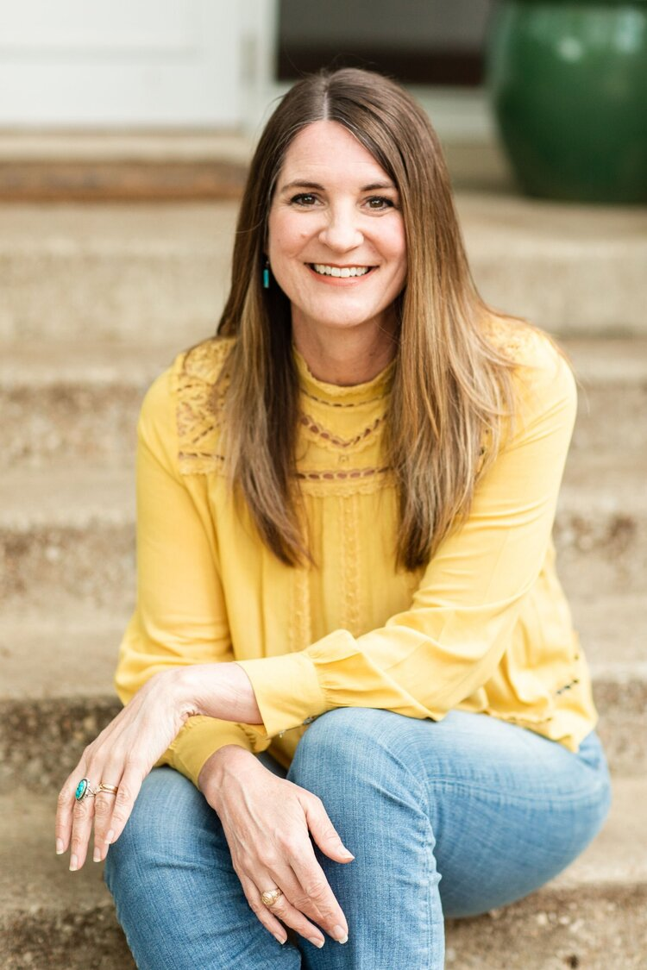
Jen Wilkin Quote

